Slide 1

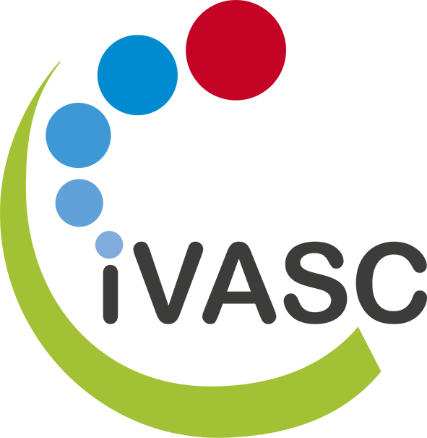






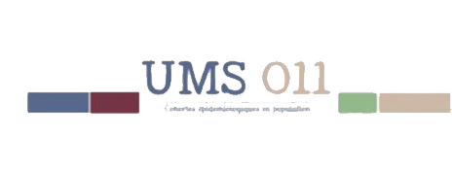







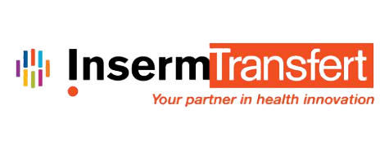


iVASC RHU
Innovation in Atherothombosis Science
Professor Gabriel Steg, cardiologist at the Bichat Hospital in Paris, is heading the newly awarded iVASC RHU. RHUs (‘Recherche Hospitalo-Universaires’) are French financial instruments to support academic researchers, physicians, and leading industrial partners that are committed to conduct translational research. The iVASC RHU is devoted to study atherothrombosis, the underlying cause of myocardial infarction and of most strokes.
What are RHUs ?
RHUs (recherches hospitalo-universitaires) are selected research programs supported by the French Government ‘Plan d'Investissement d'Avenir’.
iVASC Grant ID:
ANR–16–RHUS–00010
Most cardiovascular diseases are due to arterial obstruction (atherothrombosis). If the obstructed vessel is one that irrigates the heart, it causes a myocardial infarction; If it irrigates the brain, a stroke, with high mortality or heavy sequelae for survivors. The iVASC project aims to advance the understanding and treatment of atherothrombosis. If we add up the deaths due to heart diseases and cerebrovascular diseases, we are facing the leading cause of death in the world. This is a major public health problem.
A glass ceiling to break
In recent decades, considerable progress has been made in the field of pharmacology and curative treatment of cardiovascular diseases. For this type of diseases, the management is multiple: it involves drugs, very effective and the use of stents or surgical bypass surgery. It also involves a change in lifestyle to control well-identified risk factors for the disease (eg tobacco, high cholesterol, diabetes, hypertension, physical inactivity, obesity). Despite this, progress is slowing for several reasons.
Research tracks on the genesis and progression of the disease are fairly stereotyped and have focused much on the treatment of high blood pressure or elevated cholesterol, or on diabetes. New avenues must now be explored. The pharmaceutical industry, one of the drivers of this progress, is moving away from this area because the investments that have to be made become enormous for sometimes modest returns. The cost of conducting cardiovascular clinical trials, which involve tens of thousands of patients, becomes prohibitive. The iVASC RHU proposes new avenues of research and new modalities for clinical studies in this field.
Socio-economic impact
One of iVASC's partners is a research unit in health economics, whose task will be to assess the socio-economic impact of the recommendations that will emanate from the RHU results in order to measure the benefit society can derive from our work.
Top: Before angioplasty, the angiography shows a stenosis of the right coronary artery (yellow arrow in A). Intravascular observation by IVUS (Intravascular ultrasound) and "virtual histology" demonstrates that it is a ruptured atherosclerotic plaque with its typical crater-like appearance (B). The red color indicates the presence of a residual necrotic core at the site of rupture.
Bottom: After angioplasty and placement of a stent, the artery is completely recanalized (angiography, C). This is corroborated by visualization of the artery in OCT (optic coherence tomography) and coroscanner (E). Credit: L Feldman. AP-HP Bichat Hospital, Paris.
Risk factors that may seem extravagant, but are not
The iVASC RHU has taken the lead in addressing risk factors that, while very common (up to 80% of patients), have remained relatively neglected. These are atypical risk factors. The first is periodontal disease, an infectious disease of the mouth caused by poor oral hygiene. It may seem curious that periodontal disease may have a repercussion on the arteries. However, experimental and clinical data suggest a link. One of the axes of this RHU is precisely to establish whether there is a cause-and-effect relationship and whether better oral hygiene can prevent cardiovascular disease. The industrial partner of the iVASC RHU on this aspect is Colgate-Palmolive.
A second risk factor is to be explored by the iVASC RHU: respiratory sleep disorders. They are frequent and characterized by abnormal breaths or breaks in breathing, and insufficient ventilation during sleep. Besides the fatigue they cause, they are suspected of participating in the genesis of cardio- and cerebro-vascular accidents. With the help of the French industrial leader in the diagnosis and treatment of these disorders, ResMed, this risk factor will be explored clinically in the iVASC RHU.
Training of future practitioners
Based on the observation that there is a lack of up - to - date teaching resources on atherothrombosis in French, RHU iVASC has decided to create MOOC (massive online open course) courses, with a free access.
A new registry in France and new diagnostic tools
To progress in this area, research needs a very large number of patients. A major focus of the iVASC RHU is to establish a cohort of several thousand patients who have had myocardial infarction and followed several years (a similar study on stroke patients is also planned). This cohort will allow for accurate targeted studies of neglected risk factors. This will also allow for clinical trials to test new treatments at a fraction of the cost of current studies. And this will give French cardiovascular research a significant competitive advantage. AstraZeneca is the industrial partner that helps to build the registry.
In order to carry out this type of research, it is necessary to be able to evaluate the evolution of the disease in humans. One of the axes of the iVASC RHU is to develop molecular imaging methods to precisely identify the initiation and progression of atherothrombosis lesions in human arteries. The industrial partner of this axis is Advanced Accelerator Applications, an innovative radiopharmaceutical company that develops, produces and markets products in the field of molecular nuclear medicine.
Academic and industrial partners of iVASC
ResMed
AP-HP Hôpitaux universitaires Paris Centre - ECEVE
Inserm UMS 11 Université de Versailles Saint-Quentin en Yvelines
Inserm UMR 1241 Université de Rennes 1
Advanced Accelerator Applications
AstraZeneca
Colgate
Inserm UMR 1148 LVTS Universités Paris 7 & 13
Université Paris Descartes
AP-HP Groupe hospitalier Hôpitaux universitaires Paris Nord Val de Seine
Inserm-Transfert
AP-HP Hôpitaux universitaires Est Parisien
Département de la recherche clinique et du développement
Contact
DHU FIRE et Unité 1148 LVTS
Hôpital Bichat -46, rue Henri Huchard
75018 Paris - France
📞 + 33 1 40 25 86 00
📧 contact@ivasc.eu

